Slide 1
CJLR ePSW
Training V1.3
Date: 18th Sep 2018

Slide 2
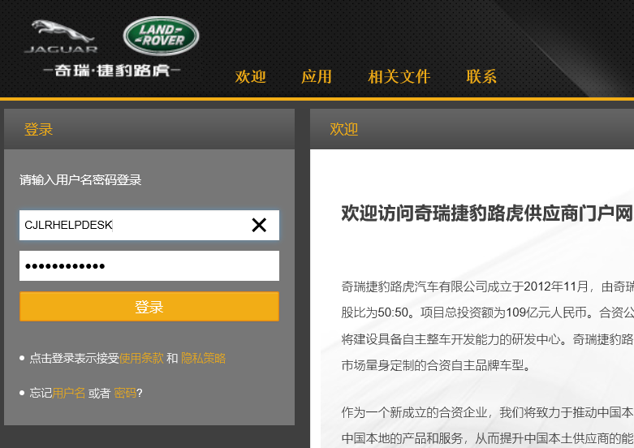
ePSW登录
ePSW Login
输入ePSW生产环境 URL: https://cjlr.portal.ap1.covapp.io
Input ePSW production URL: https://cjlr.portal.ap1.covapp.io
输入用户名，密码，点击登录。
Enter the user name, password, and click login

Slide 3
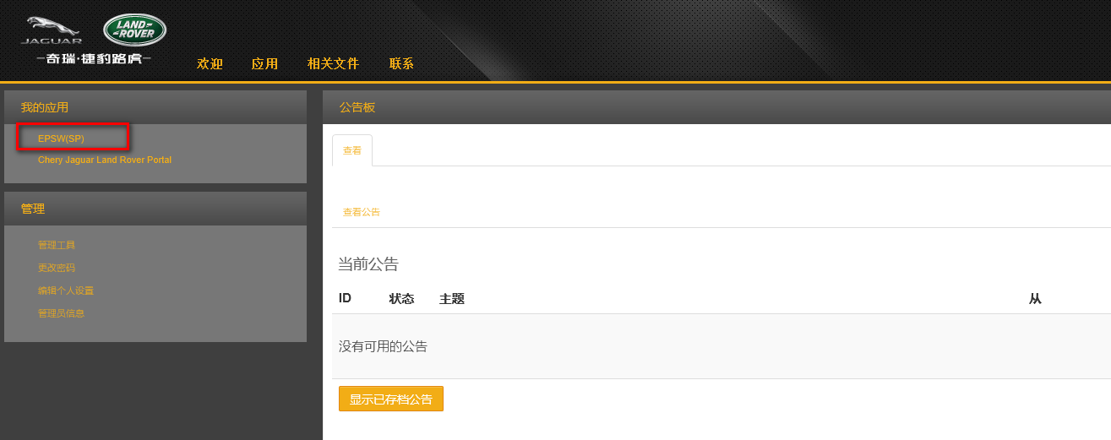
登录页面-Login Page
账号密码输入完成后，点击界面左侧‘我的应用’中的‘CJLR ePSW 进入系统
After the password is entered, click "CJLR ePSW" in "my application" on the left side of the interface to enter the system

Slide 4
ePSW登录
ePSW Login
注意：
1、供应商必须已经在Supply Portal中注册
2、供应商用户名和密码也必须已经在Supply Portal中注册
3、供应商及供应商帐号注册请联系 Covisint Helpdesk.
Note:
1. The supplier must have registered in Supply Portal
2. The supplier user name and password must also be registered in Supply Portal
3. For supplier and supplier account registration, please contact Covisint Helpdesk.
浏览器要求：IE11, FIREFOX,CHROME 。
考虑到CJLR SRM 系统对浏览器的要求， 推荐使用Firefox.
Browser requirements: IE11, FIREFOX,CHROME.
Firefox is recommended, given the requirements of the CJLR SRM system for browsers.

Slide 5
ePSW登录
ePSW Login
密码修改：
1、与现有SRM账号策略保持一致
2、如有问题请联系Covisint helpdesk

Slide 6
ePSW整体功能介绍
High Level Lifecycle Overview
PSW主要分四部分：
PSW Form
Checklist
附件
声明
The PSW consists of four sections:
PSW Form
Checklist
Attachments
Declaration

Slide 7
ePSW整体功能介绍
High Level Lifecycle Overview
PSW审批状态说明：
PSW为Phase 1 且Level 1 ，则不需要审批。
PSW为Phase 1/2/3, Level 2/3/4 ，则只需要PD一级审批即可。
PSW为Phase 1/2/3, Level 5, 则需要先进行PD一级审批，PD 审批通过后，STA进行二级审批。
IPSW: 所有的IPSW，都需要二级审批，即先进行PD一级审批，PD 审批通过后，STA进行二级审批
PSW Approval instructions:
EPSW Phase 1 , Level 1 do not require PD/STA approval.
EPSW Phase 1/2/3, Level 2/3/4 only requires STA Level I approval.
EPSW Phase 1/2/3, Level 5, requires the first stage approval of PD. After the approval of PD is passed, STA will proceed the second stage approval.
IPSW, Level 1/2/3/4/5, requires the first Level approval of PD. After the approval of PD is passed, STA will proceed to the second Level approval.

Slide 8
功能介绍
Function Introduction
ePSW（SP）系统主要功能如下：
Partlist： Partlist中显示所有SRM系统传给ePSW系统的 COSTBOOK, PACN相应的零件信息。
新增PSW：用户选中需要创建PSW的零件，点击新增PSW，即可进入PSW新增界面。
单个创建PSW:用户选择一个PSW零件，点击新增PSW，即可进入PSW新增界面，在PSW新增界面完善相应的PSW信息即可。
批量创建PSW:用户选择多个PSW零件，点击新增PSW，系统自动生成多个PSW单据， 用户需要到Worklist界面查看已批量生成的PSW单据，然后再打开每个PSW单据完善相应的PSW信息。
批量创建PSW(TO-BE): 在ePSW后续CR中会针对批量创建 PSW进行优化，即未来的业务操作如下：
用户选择多个PSW零件，点击新增PSW
用户选择批量创建方式： 合并、单一
合并：如果用户选择合并创建方式，则系统会自动把选择的多个Part No 创建到同一个PSW中。
单一：如果用户选择单一创建方式，则系统则根据每个Part No分别生成相应的PSW。
Partlist： There are 2 resource of Partklist: SRM COSTBOOK, SRM PACN
NEW PSW ：In the Part list interface, select the Part number that needs to be created for PSW, and click the button 'NEW PSW‘。In the ’New PSW’ page, Enter the following values to create a new PSW submission.
Single: The user selects a PSW part, clicks the new PSW button, enters the new page of PSW, and enters the specific PSW information.
Batch(As-Is):The user selects multiple PSW parts and clicks the new PSW button to generate multiple PSW automatically. The user needs to go to the Worklist interface to view the batch generated PSW documents, and then open each PSW document to improve the corresponding PSW information.
Batch(TO-BE):
The user selects multiple PSW parts and clicks the new PSW
Users can select batch creation method: merge, single
Merge: if the user chooses the merge creation method, the system will automatically create multiple Part nos selected into the same PSW.
Single: if the user chooses a single creation method, the system will generate corresponding PSW according to each Part No.

Slide 9
功能介绍
Function Introduction
ePSW（SP）系统主要功能如下：
Worklist: Worklist中显示所有已创建成功的PSW数据。用户可以打开PSW进行修改或查看。
PSW的状态主要有： Draft, Submitted, Accepted, Rejected, InterimActive
草稿: 用户创建成功还未提交成功。草稿状态的PSW可以打开再进行编辑
已提交: 用户完善相应的PSW信息，提交成功。
PD审批通过：PSW已被PD审批通过。
审批通过: PSW已被STA审批通过
审批退回: PSW被PD或STA审批退回，退回状态的PSW可以打开再进行编辑
IPSW 审批通过: IPSW已被STA审批通过
Worklist: The My Worklist screen displays the PSWs that require your attention.
There are 5 status of PSW: Draft, Submitted, Accepted, Rejected, InterimActive
Draft: PSW has been created but not yet submitted
Submitted: PSW has been submitted to CJLR for review
Accepted PD: PSW has accepted by PD Engineer
Accepted: PSW has been accepted by CJLR
Rejected: PSW has been rejected by CJLR STA/PD Engineer
InterimActive: Interim PSW has been accepted by JLR STA Engineer

Slide 10
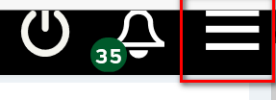
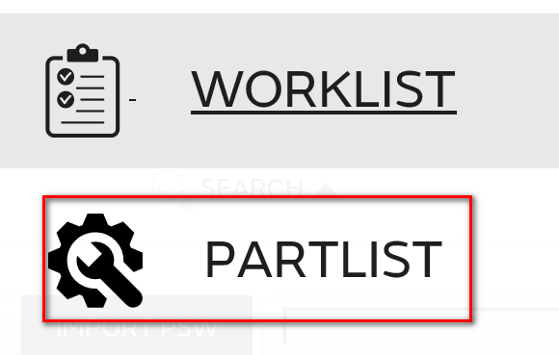
零件列表
Partlist
用户进入系统后，点击右上角的图标
用户进入系统入，点击右上角的图标，进入以下界面：
Clicking Partlist from My Menu. User is able to view all status Partlist if there is any.

Slide 11
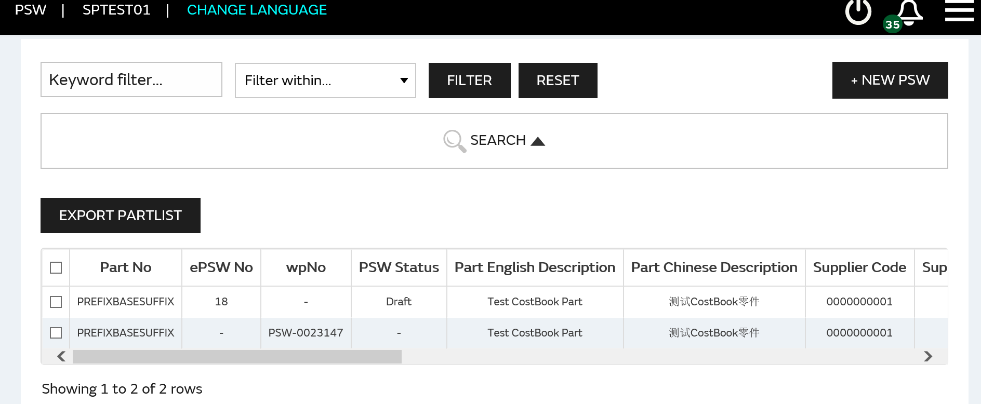
零件列表
Partlist
选择‘Part list’，进入Part list’列表界面。
Select 'Part list' and enter the Part list page:
供应商登录系统后，默认进入Partlist 列表界面。
When the supplier logs into the system, by default, it enters the Partlist list interface
Part list界面显示的数据为SRM 系统传过来的所有需要创建PSW单据的零件信息（包含PACN, COSTBOOK两种情况）
There are 2 resource of Partklist: SRM COSTBOOK, SRM PACN。

Slide 12
零件列表-创建PSW
Partlist-New PSW
在Part list界面，选择需要创建PSW的行（零件号），点击’NEW PSW’按钮
In the Part list interface, select the Part number that needs to be created for PSW, and click the button 'NEW PSW'
点击’NEW PSW’按钮，进入PSW 创建界面，输入相应的PSW信息后，点击保存即可。
In the ’New PSW’ page, Enter the following values to create a new PSW submission.

Slide 13
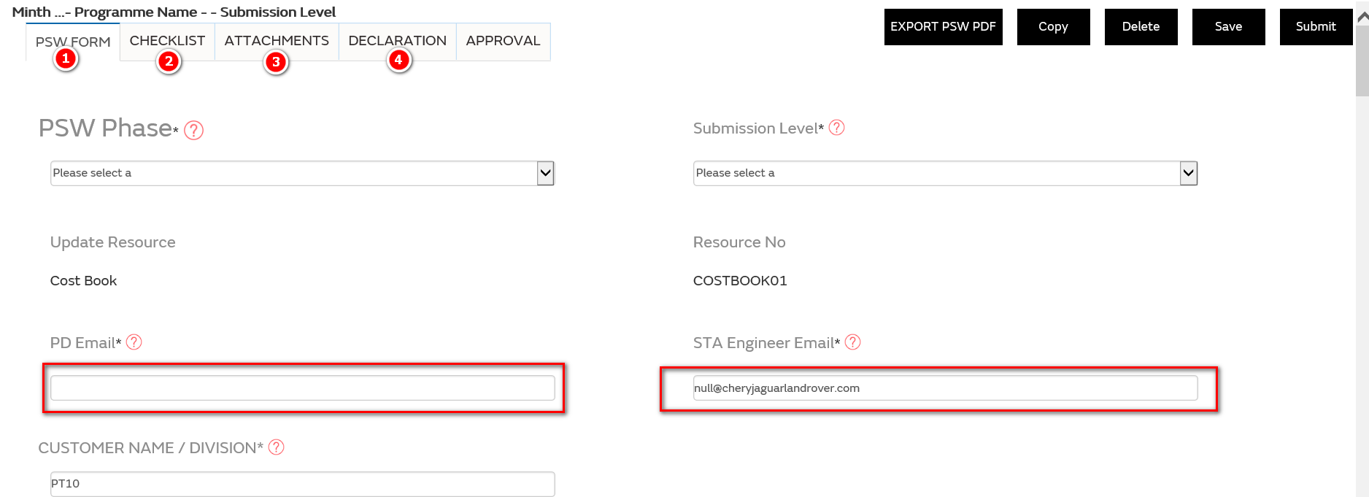
零件列表-创建PSW
Partlist-New PSW
一个PSW 主要由以下几个组成部分：PSW Form, Checklist ,附件，声明
The main components of the ePSW are as follows: PSW Form，Checklist，Attchments ，Declaration
PSW保存后，在WORK LIST界面就会新增一条记录，点击 VIEW即可查看
After PSW is saved, a new record will be added in the WORK LIST interface. Click VIEW to VIEW it
注意： 只能选择还未创建生成PSW NO的零件号进行创建，否则系统提示，已存在相应的PSW ，不能创建。
Note: only the part number that has not been created to generate the PSW NO can be selected for creation, otherwise the system prompts that the corresponding PSW already exists and cannot be created
如果创建Phase 3 PSW遇到问题，请查看第44页
Any Problem with creating phase 3 psw, please turn to page 44.

Slide 14
PSW Form
第一步：输入PSW Form基本信息

Slide 15
PSW Form
PSW FORM：
选择PPAP Phase: 可以选择Phase 1， Phase 2， Phase 3， Interim (Non PPAP).
Select the PPAP Phase. Options are Phase 1, 2, and 3 and Interim (Non PPAP).
注意：
如果是PHASE 3, 则 CAR附件一定要上传
If it is PHASE 3, the CAR attachment must be uploaded
如果是IPSW,则WERS Alert 附件一定要上传
If it's an IPSW, the WERS Alert attachment must be uploaded

Slide 16
PSW Form
PSW FORM：
选择Submission Level ， 可以选择 Level 1， Level 2， Level 3， Level 4， Level 5
Select the Submission Level from the list of values. Options are Level 1,2,3,4 and 5.
输入PD工程师邮箱，邮箱后缀必须是@cheryjaguarlandrover.com。当 PPAP Submission Level为 Level 5 或是Interim PSW 时， PD工程师邮箱必须输入。
Enter the PD Engineer email address. The postfix must be: @cheryjaguarlandrover.com. (Only applicable for PPAP Submission Level 5 and for ALL Interim PSW submissions)
输入STA工程师邮箱，邮箱后缀必须是@cheryjaguarlandrover.com。当 PPAP Submission Level为 Level 2，3，4 或是Interim PSW 时， PD工程师邮箱必须输入。
Enter the STA Engineer email address. The postfix must be: @cheryjaguarlandrover.com. (Only applicable for PPAP Submission Level 2, 3, 4 and 5 and for ALL Interim PSW submissions).

Slide 17
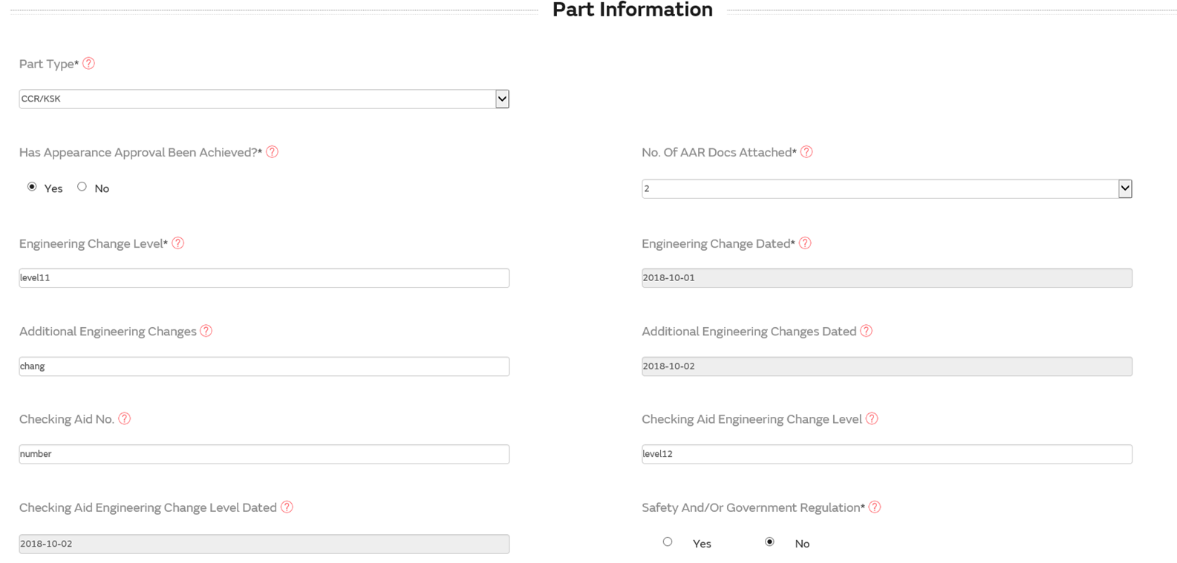
PSW Form
第二步：输入零件基本信息

Slide 18
PSW Form
PSW FORM：
选择零件类型，零件类型有：单一，多个， CCR三种类型。
单一： 表示PSW中只包含一个零件号
多个：表示同一个PSW中可以包含多个零件号
CCR/KSK：表示该PSW是总成件
Select the appropriate Part Type. The value determines how the user will enter part details and what validation will be performed by ePSW.
Single: PSW covers a single part.
Multiple: PSW covers multiple parts.
CCR: PSW covers a Complex Commodity Release (also to be used for KSK).
如果是CCR/KSK, 则CCR/KSK附件一定要上传
If CCR/KSK, CCR/KSK attachment must be uploaded

Slide 19
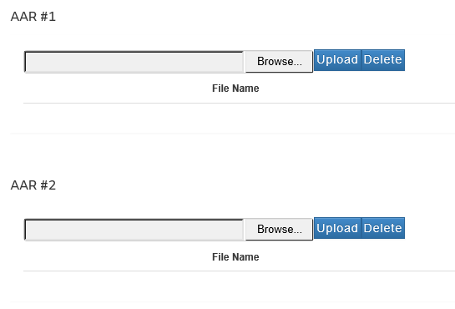
PSW Form
PSW FORM：
选择是否是AAR
Select the Appearance Criteria (AAR).
选择AAR附件数量，这里选择的数量是多少，就需要在附件上传界面上传多少份附件文件。
Select the Number of AAR files attached.Specify how many Appearance Approval Report files will be attached to the PSW

Slide 20
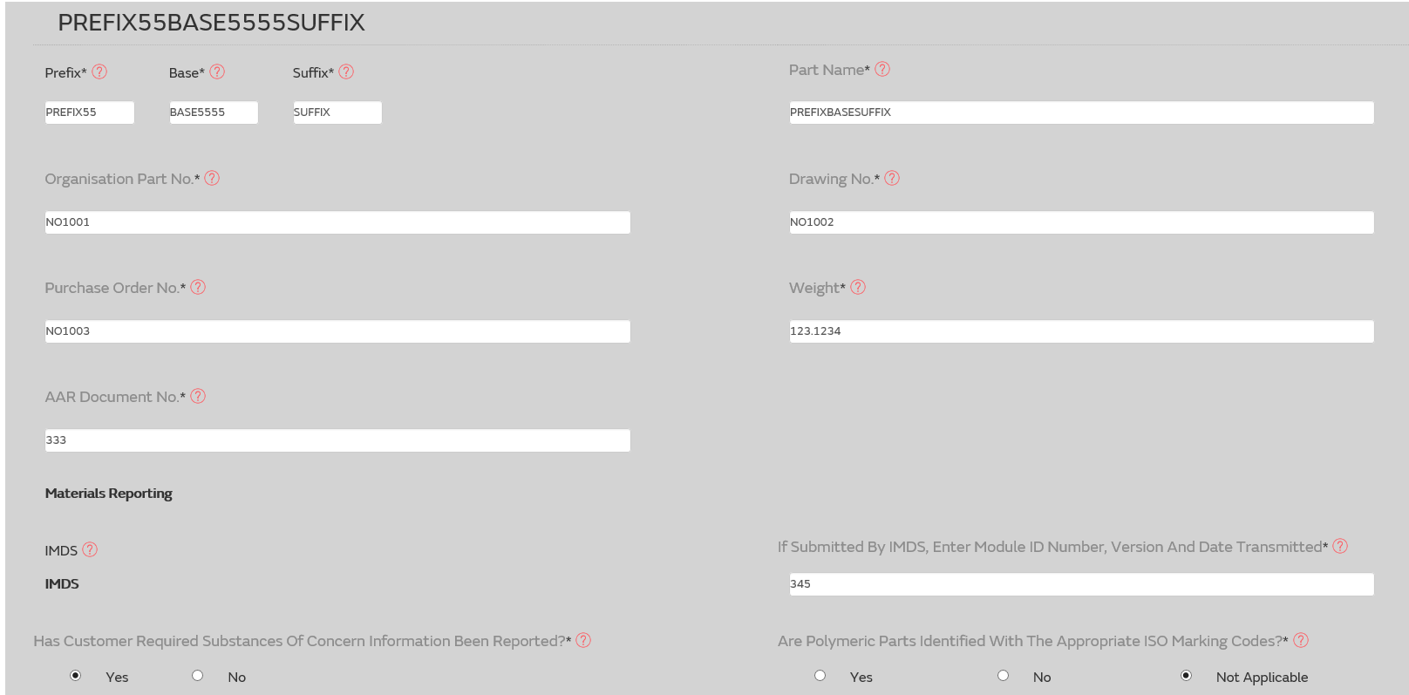
PSW Form
PSW 零件信息：

Slide 21
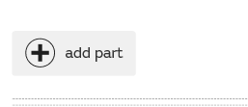
PSW Form
PSW FORM：
零件号：零件号系统自动带出.
Prefix, Base and Suffix: This will be completed automatically from Partlist.
零件描述：零件描述系统自动带出.
The Part Name is the Part Description. This will be completed automatically after the part number is entered.
Note:如果PSW类型为： Multiple，那么可以选择添加零件号按钮，增加新的零件信息。
If the type of PSW is: Multiple, you can choose to add the part number button to add new part information.
零件号可修改，修改后，系统会核验零件号是否存在，否则系统提示零件号不存在，PSW无法提交。CCR除外。
The part number can be modified. After modification, the system will check whether the part number exists, otherwise the system will suggest that the part number does not exist and PSW cannot be submitted. Except the CCR。

Slide 22
PSW Form
PSW FORM：
输入重量：重量必须包含4位小数，例如：10.0000
Enter the actual Weight in kilograms to four decimal places.

Slide 23
PSW Form
第三步：输入客户提交 信息：

Slide 24
PSW Form
第四步：输入提交的理由（至少选择一个），如果有一项为NO,则必须输入理由。
Submission Results Note: you are required to answer Yes to all questions in the Submission results section. If any answers are No, an explanation must be entered in the Submission Result Explanation field.

Slide 25
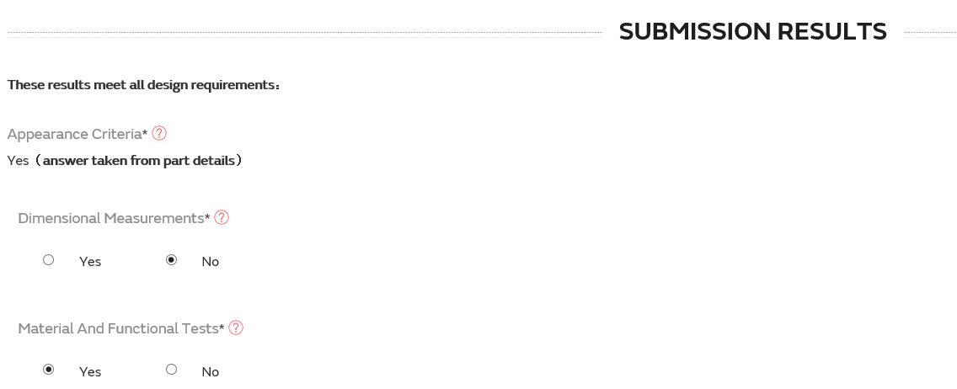
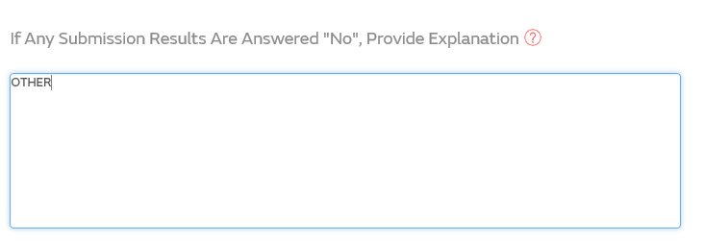
PSW Form
第五步：填写提交结果。如果有任一项为NO,则必须填写原因说明。
Step 5: fill in the submission results. If any answers are No， Provide Explanation.

Slide 26
PSW Form
第五步：填写提交结果。如果有任一项为NO,则必须填写原因说明。
Step 5: fill in the submission results. If any answers are No， Provide Explanation.

Slide 27
PSW Checklist
PSW Checklist:
其中 Control Plan Number , Control Plan Issue Level 为必填项
Extraordinary Control Plan Number ， Extraordinary Control Plan Issue Level 为非必填项。
Enter the Control Plan Number and Control Plan Issue Level.
Enter the Extraordinary Control Plan Number and Extraordinary Control Plan Issue Level where applicable.

Slide 28
PSW Checklist
PSW Checklist:
针对每项待检查列表选择 Yes , No 或 N/A
1、如果是IPSW, 选择NO,必须填写原因，则允许提交（IPSW中的Checklist 必须要有选择NO的）
2、如果是IPSW, 选择N/A,则系统提示，必须填写原因，填写原因后可以提交。
2、如果是Normal PSW,选择NO， 则系统提示，必须填写原因，不允许提交。
3、如果是Normal PSW,选择N/A，则系统提示，必须填写原因，填写原因后可以提交。
4、特殊情况： 针对Checklist 17.1：
1）如果是 Phase 1或者Phase 2, 选择N/A，则系统提示，必须填写原因，填写原因后可以提交。
2）如果是Phase 3， 选择N/A或NO，必须填写原因，则系统提示，不允许提交.
All checklist items require a Yes , No or N/A answer in the Status OK? field.
If No is selected for any item, the PPAP Phase in the PSW form must be set to Interim PSW, otherwise an error message will display when you try to submit the PSW. For the most item which selected as ‘N/A’, system will skip the validation, except for the item 17.1.
17.1 is Phase 3 PSW specific. If N/A selected for Phase 1 this will be OK, with reason added as above. But if No or N/A selected for Phase 3 PSW the system must recoganise this and flag an alarm. If the ‘N/A’ is selected, a comment is required.
All checklist items require Status OK to be set to Yes or No. An Interim PSW will have at least one item set to No.
If Supplier select N/A, system will skip the verification for this line item.

Slide 29
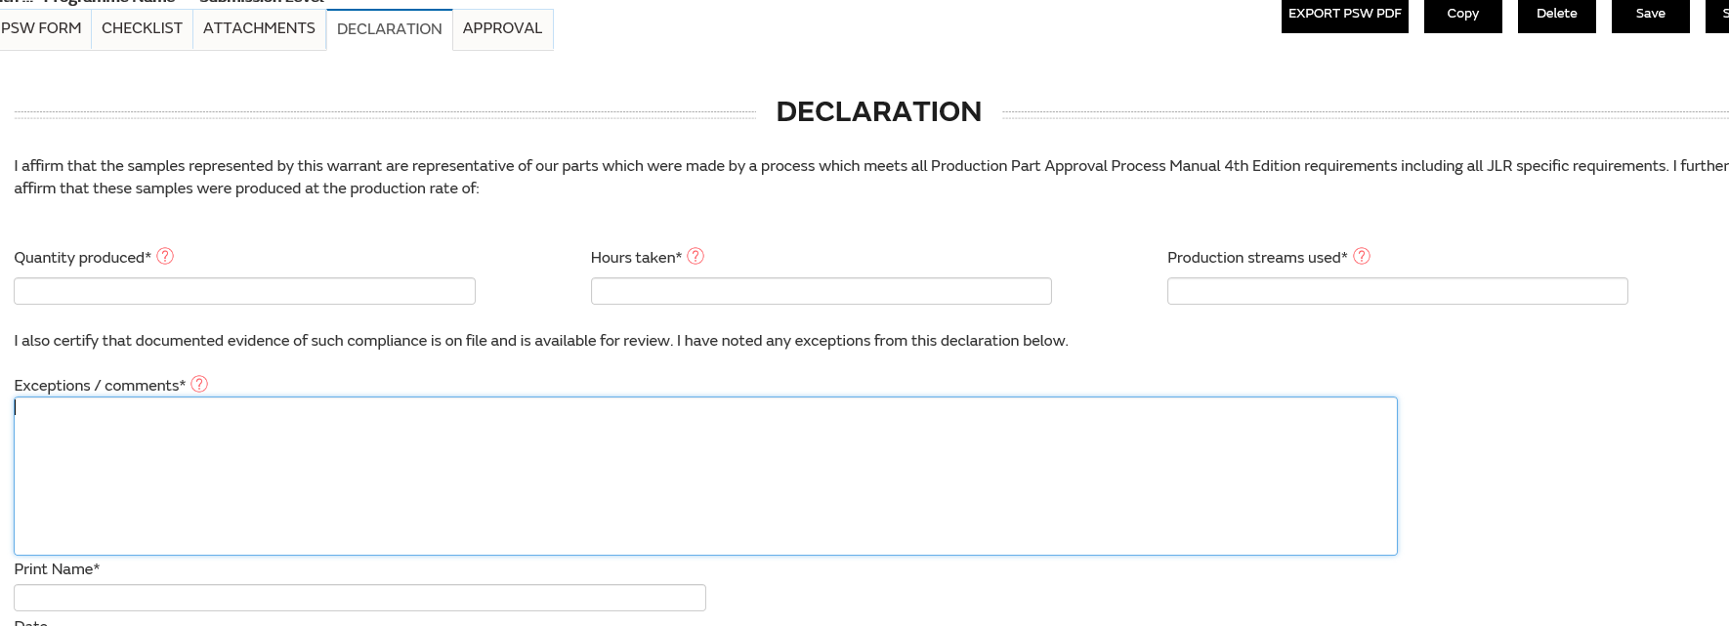
PSW Declaration
PSW Declaration:
填写PSW声明部分相关信息：
Fill in the information related to PSW declaration
其中字段‘生产数量，生产小时数，所用的生产线条数，解释/说明，经授权的供应商代表签名’为必填项
The field ‘Quantity produced, Hours taken, Production streams used , Exceptions / comments, and Organisation Authorised Signature' must be filled in

Slide 30
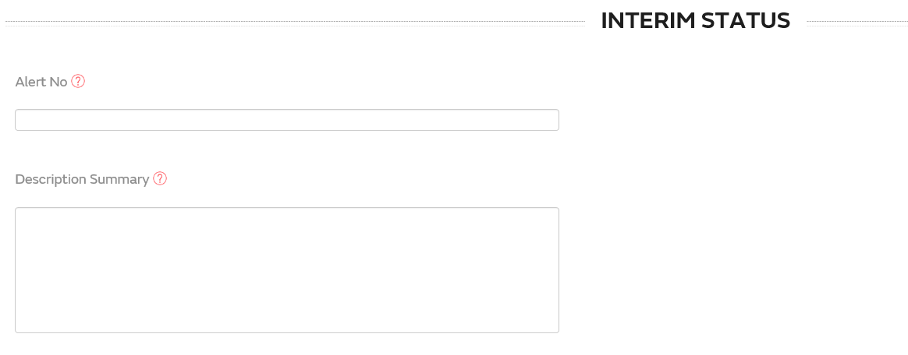
IPSW
PPAP Phase选择： Interim (Non PPAP)
Select Interim (Non PPAP) for the PPAP Phase.
必须输入PD/STA的邮箱
Enter the PD/STA Engineer email address.
Checklist 选项中必须至少有一项选择为NO。
All checklist items require Status OK? to be set to Yes /No/NA. An Interim PSW will have at least one item set to No.
必须输入Alert Number ， Description Summary 。
Enter the Alert Number and Description Summary
必须上传Alert附件。
Attach a copy of the WERS alert and any other required documents.

Slide 31
Part list- 快捷查询
快捷查询：仅支持Part no, Supplier code, Mfg Site code 三种数据条件的快捷查询。
①先选择需要的快捷查询条件，
然后在②处输入相应的关键值，
点击③FILTER按钮，即可查询出相应的Part list数据。
点击RESET WORKLIST④按钮可重置查询条件。
Only supports quick query of Part no, Supplier code, Mfg Site code.
First selects the required quick query condition, Input search criteria, Click FILTER Button, the PSW matched with the condition will display in the search result.
Input search criteria, Click RESET Button, all inputted search criteria information will be cleared.

Slide 32
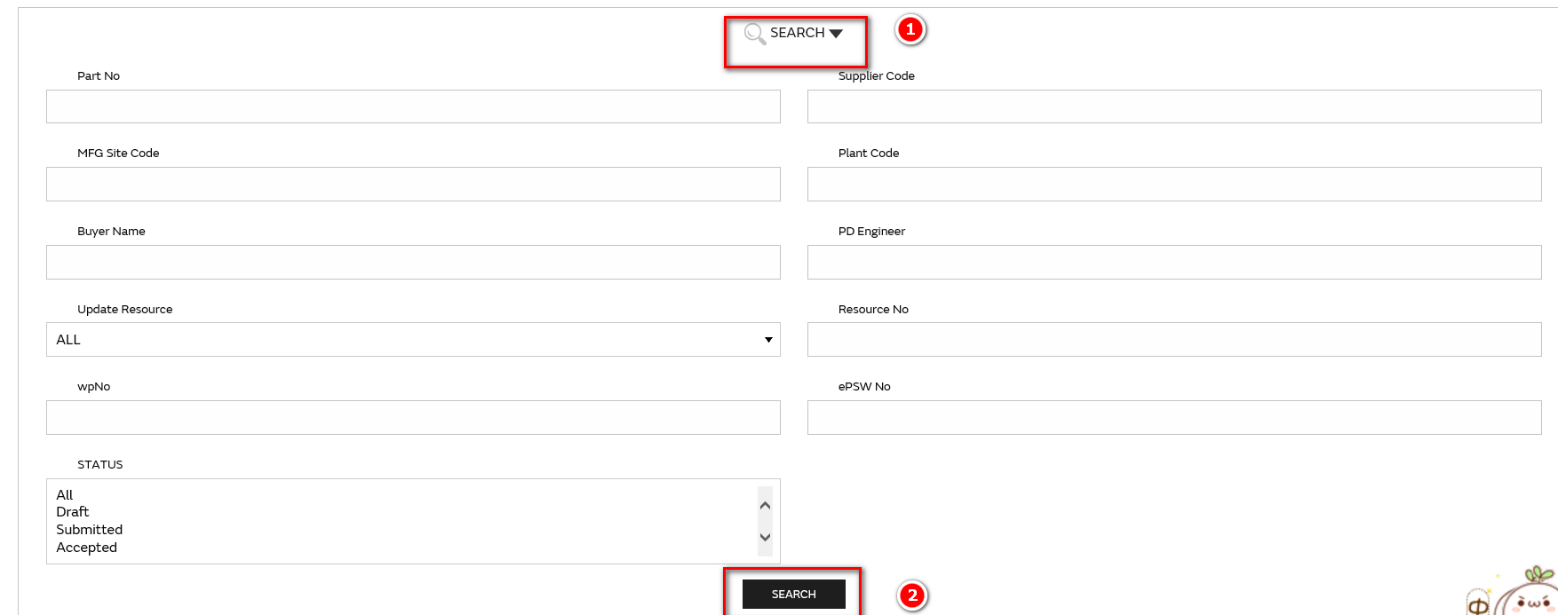
Part list- 详细查询
点击SEARCH ⑤ ,展开详细的查询条件：
根据需要输入相应的查询条件，点击⑤ SEARCH按钮，即可查询出相应的ePSW数据。
再次点击SEARCH ⑥ 可隐藏详见查询条件。
Click SEARCH①to expand the detailed query conditions:
Input search criteria, Click Search② Button, the PSW matched with the condition will display in the search result.

Slide 33
Part list- 详细查询
点击SEARCH ⑤ ,展开详细的查询条件：
根据需要输入相应的查询条件，点击⑤ SEARCH按钮，即可查询出相应的ePSW数据。
再次点击SEARCH ⑥ 可隐藏详见查询条件。
Click SEARCH①to expand the detailed query conditions:
Input search criteria, Click Search② Button, the PSW matched with the condition will display in the search result.

Slide 34
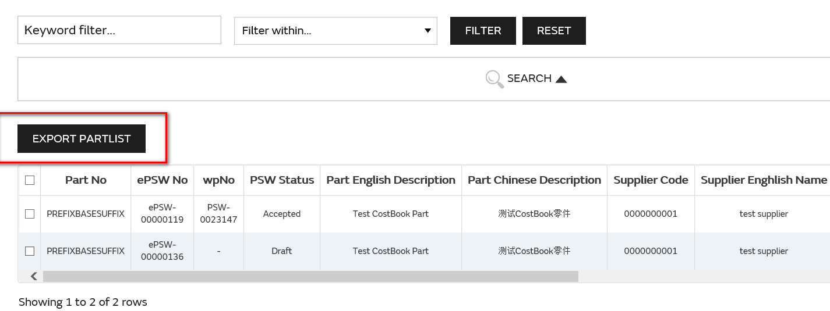
Partlist-Export Partlist
在Partlist列表界面，可以通过查询条件筛选出所需要的零件列表，然后导出EXCEL。
In the‘ Partlist’ list page, select the Part data to be exported, and click the Export PARTLIST button.
导出的EXCEL格式如下
The exported PARTLIST Form template is as follows:

Slide 35
PSW-Delete/Save/Submit/Copy
PSW其它主要功能说明：
1、删除：所有Draft状态的PSW均可删除
2、保存：用户填写PSW相关信息后，点击保存，即可保存当前输入内容。
3、提交：所有信息填写完毕后，点击Submit按钮，提交PSW。提交时，系统会校验PSW内容是否输入正确，完整， 如果没有，则无法提交成功且系统给出相应提示
4、复制：复制成功后，原PSW保持不变；新PSW状态为草稿状态，仅PSW FORM、CHECKLIST信息复制成功。
Other main functions of PSW:
1. Delete: PSW in all Draft state can be deleted
2. Save: after users fill in relevant information of PSW, click save to save the current input content.
3. Submit: after completing all information, click the Submit button to Submit the PSW. When submitting, the system will verify whether the PSW content is entered correctly and completely. If not, it cannot be submitted successfully and the system will give corresponding prompt
4. Copy: after the successful replication, the original PSW remains unchanged; The new PSW status is draft status, only the PSW FORM and CHECKLIST information copied successfully.

Slide 36
PSW-撤回
PSW提交后，在PD或STA均为审批前，可以撤回，PSW撤回后，可以重新修改后再提交。
After PSW submits, it can be withdrawn before PD or STA is approved. After PSW submits, it can be modified and submitted again.
进入PSW详情界面可以导出PDF格式的PSW文件。
click the EXPORT PSW PDF button, Download ePSW in PDF format.

Slide 37
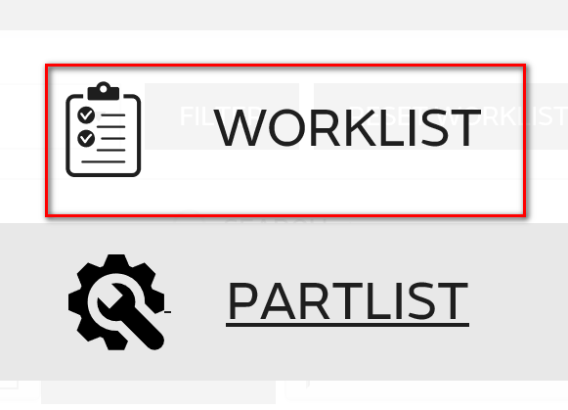
Work list
用户进入系统后，点击右上角的图标
用户进入系统入，点击右上角的图标，进入以下界面：
Clicking Partlist from My Menu. User is able to view all status Worklist if there is any.

Slide 38
Work list-View
在Work list 列表界面，点击View按钮,可打开查看相应的ePSW具体界面：
点击View按钮，打开具体的PSW详情界面，如下：

Slide 39
Work list-Query
快捷查询：支持Program Name, Part no, Phase 三种数据条件的快捷查询。
①先选择需要的快捷查询条件，然后在②处输入相应的关键值，点击③FILTER按钮，即可查询出相应的ePSW数据。
点击RESET WORKLIST④按钮可重置查询条件。
Only supports quick query of Program Name, Part no and Phase.
First selects the required quick query condition, Input search criteria, Click FILTER Button, the PSW matched with the condition will display in the search result.
Input search criteria, Click RESET WORKLIST Button, all inputted search criteria information will be cleared.

Slide 40
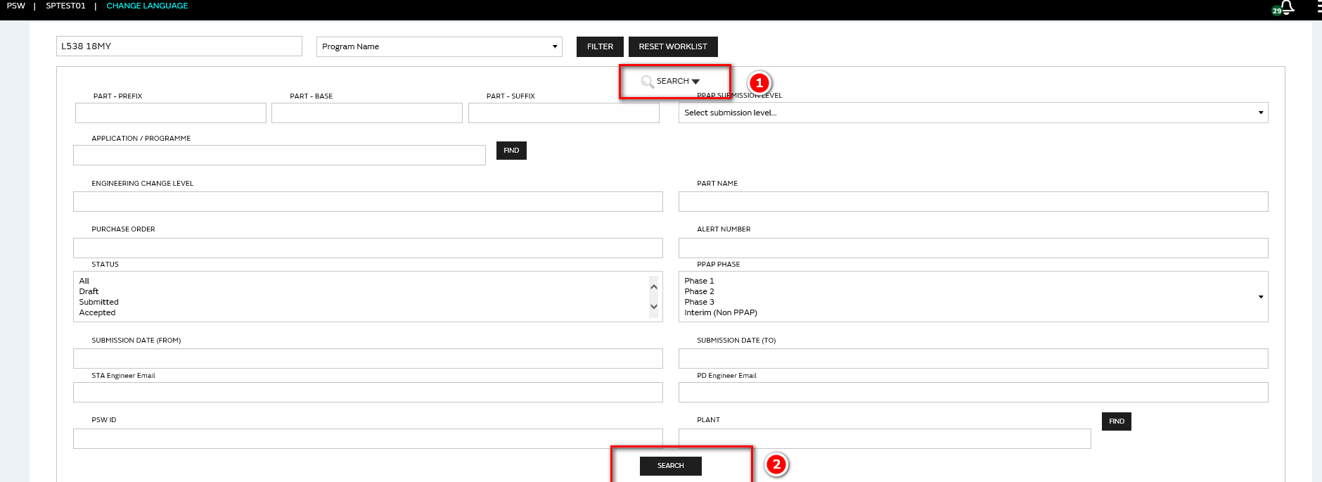
Work list-Query
2、点击SEARCH ① ,展开详细的查询条件：
Click SEARCH① to expand the detailed query conditions:
根据需要输入相应的查询条件，点击② SEARCH按钮，即可查询出相应的ePSW数据。
再次点击SEARCH ① 可隐藏详见查询条件。
Input search criteria, Click Search Button, the PSW matched with the condition will display in the search result.

Slide 41
Work list-Export PSW
1、在Work list 列表界面，选择需要导出的ePSW数据，点击 Export PSW按钮，可以导出PSW Form 中的内容，这里可以选择一个PSW导出，也可以选择多个PSW一起导出。
In the ‘Work list ’list interface, select the ePSW data to be exported. Click Export PSW button to Export the content in the PSW Form. Here, you can select one PSW Export or multiple PSW Export together.
导出的ePSW模板如下（红色字体代表必填项）：
The exported ePSW template is as follows (red font for mandatory fields)

Slide 42
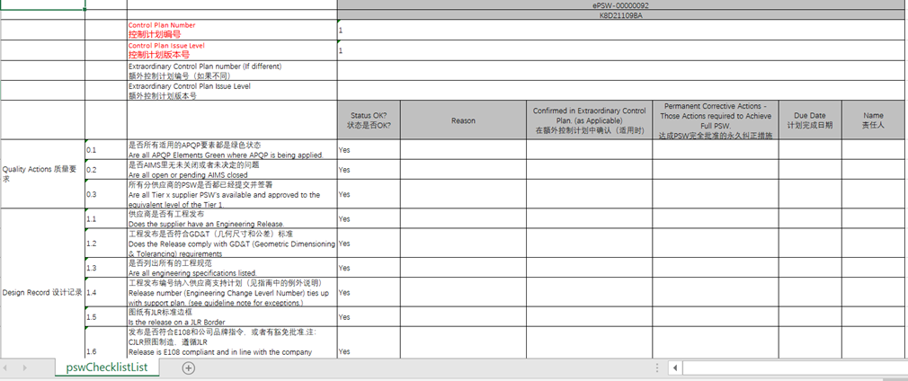
Work list-Export Checklist
1、在Work list 列表界面，选择需要导出的ePSW数据，点击 Export Checklist 按钮，可以导出PSW Checklist 中的内容，这里可以选择一个PSW导出，也可以选择多个PSW一起导出。
In the ‘Work list ’list interface, select the ePSW data to be exported. Click Export Checklist button to Export the content in the PSW Checklist. Here, you can select one PSW Export or multiple PSW Export together.
导出的ePSW模板如下（红色字体代表必填项）：
The exported ePSW template is as follows (red font for mandatory fields)

Slide 43
Work list-Import PSW/ Checklist
1、在导出的PSW Form 文件中修改相应的内容，然后点击 上传PSW按钮，即可更新相应的PSW Form 内容。
2、在导出的PSW Checklist 文件中修改相应的内容，然后点击 上传PSW Checklist按钮，即可更新相应的PSW Checklist 内容
1. Modify the corresponding content in the exported PSW Form file, and then click the button of uploading PSW to update the content of the corresponding PSW Form.
2. Modify the corresponding content in the exported PSW Checklist file, and then click the "upload PSW Checklist " button to update the content of the corresponding PSW Checklist
注意：
1、导入时，PSW NO 须已经在系统中存在。
2、导入时，PSW必须是未提交状态。
Note:
1. When importing, PSW NO must already exist in the system.
2. When importing, PSW must be uncommitted.

Slide 44
Create Phase 3 PSW
创建Phase 3的PSW
First open the Phase 1 PSW in Worklist and press on the Copy button to get a new draft psw form with the same info generated automatically. Then set the phase from 1 to 3 and complete following steps
在Worklist中，选则已完成审批的相应Phase 1的psw并打开，点击“参考创建”按钮，复制出一个新的psw并保存为草稿，表单内容会自动填充，与phase 1表单的内容一致，并可以手动修改。而后把这个新的psw表单上的phase从1改成3即可。

Slide 45
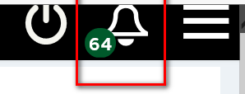
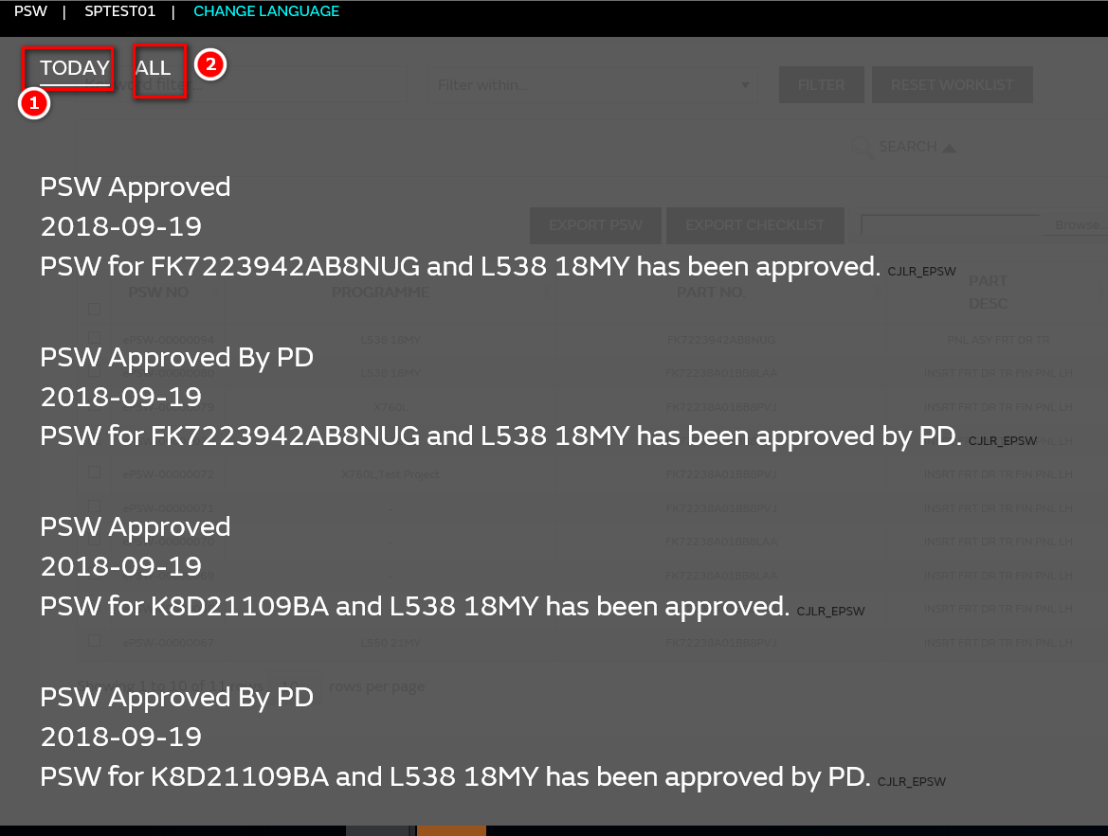
Notification
点击图标，即可查看系统消息提醒
Click the icon to view the system message reminder
系统消息提醒
①TODAY：显示今天所有的未查看的消息提醒信息
②ALL：显示截止到当前所有的未查看的消息提醒信息
TODAY: displays all unviewed message alerts for TODAY
ALL: displays ALL messages that have not been checked up to the current time
以下情况均会有消息提醒和邮件提醒：
1、PSW提交
2、PSW审批通过
3、PSW审批拒绝
There will be message and email reminders for the following situations:
1. PSW submission
2. PSW approved
3. PSW's approval and refusal

Slide 46
Helpdesk联系方式
Helpdesk联系方式
邮箱:
cov-apservdesk@opentext.com
电话:
21 6171 3290（8：30~18 : 00）
系统用户手册及操作视频：
https://cjlr.portal.ap1.covapp.io
Notes:
增加helpdesk的相应时间或者SLA，紧急联系人

